Slide 1
Bell Work: Get a Book and Finish From Last Time…
Page 224 # 7, 31, 51, 53, 55, 72
Page 234 # 7, 9, 15, 17, 19, 23, 25, 27, 53, 67, 85, 93
Page 241 # 19, 21, 29, 31, 33, 45, 47, 49, 67, 69

Slide 2
Pre-calc trig
Day 25

Slide 3

Review: Properties of Logarithms
$\log_{a}{1=0}$ → $a^{0}=1$
$\log_{a}{a=1}$ → $a^{1}=a$
$\log_{a}{a^{x}=x}$ → $a^{\log_{a}{x}}=x$
$$\log_{a}{x=}\log_{a}{y=}>x=y$$

Slide 4
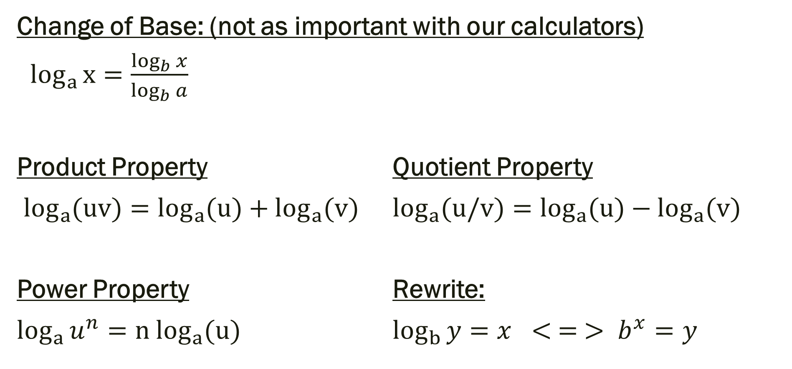
Review: More Properties
Change of Base: (not as important with our calculators)
$\log_{a}{x}=\frac{\log_{b}{x}}{\log_{b}{a}}$
Product Property Quotient Property
$\log_{a}{(uv)}=\log_{a}{(u)}+\log_{a}{(v)}$ $\log_{a}{(u/v)}=\log_{a}{(u)}−\log_{a}{(v)}$
Power Property Rewrite:
$\log_{a}{u^{n}}={n log}_{a}{(u)}$ $\log_{b}{y}=x < = > b^{x}=y$

Slide 5
3.4 Exponential and Log Equations
Objective:
Solve exponential and log equations

Slide 6
Strategies to Solve:
1.) One to One: rewrite so the bases are the same and compare
2.) Rewrite exponential in log form and apply the Inverse Property
3.) Rewrite log in exponential form and apply the Inverse Property

Slide 7

Examples: Solve
${1.) 3}^{x}=81$
2.) ln x–ln 2 = 0
${3.) 2}^{x}=8$
${4.) log}_{6}{2x=4}$

Slide 8
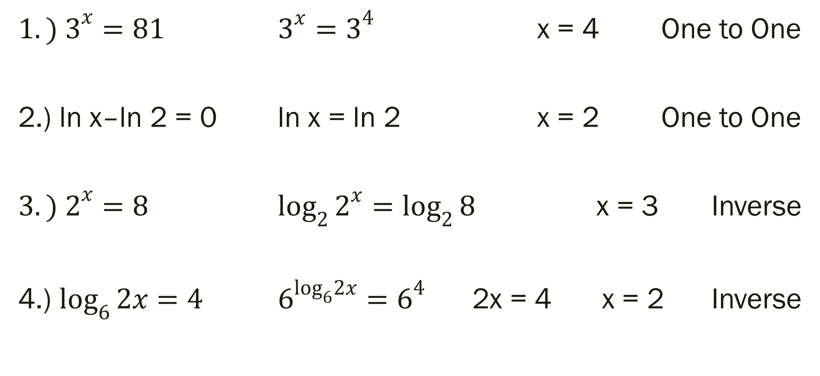
Examples
${1.) 3}^{x}=81$ $3^{x}=3^{4}$ x = 4 One to One
2.) ln x–ln 2 = 0 ln x = ln 2 x = 2 One to One
${3.) 2}^{x}=8$ $\log_{2}{2^{x}=\log_{2}{8}}$ x = 3 Inverse
4.) $\log_{6}{2x=4}$ $6^{\log_{6}2x}=6^{4}$ 2x = 4 x = 2 Inverse

Slide 9
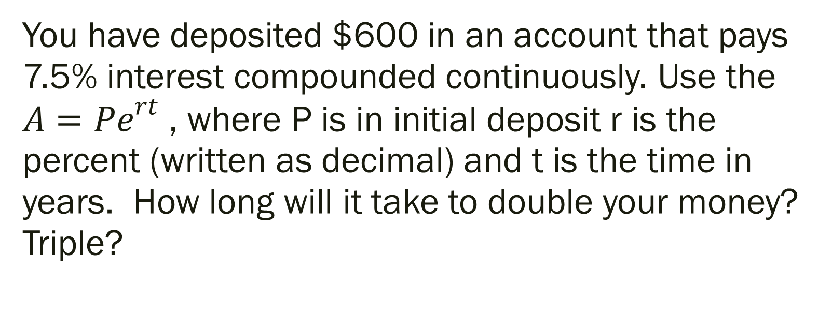
Answer the following.
You have deposited $600 in an account that pays 7.5% interest compounded continuously. Use the ${A=Pe}^{rt}$ , where P is in initial deposit r is the percent (written as decimal) and t is the time in years. How long will it take to double your money? Triple?

Slide 10

Set Up Solution
${A=Pe}^{rt}$ → ${1800=600e}^{0.075t}$ → ${3=e}^{0.075t}$ → t = ???
P = 600
r = 0.075
A = 1800 (tripled the P)
t = time

Slide 11

Additional Examples
1.) ${8(2)}^{x}−10=70$ 5.) $3^{5x}=3^{3x−8}$
${2.) 5(3)}^{6x−12}+12=32$ ${6.) log}_{7}{(4x−7)=\log_{7}{(x+8)}}$
${3.) 4e}^{x+1}=12$ 7.) ln (6x – 1) = 3
${4.) 4log}_{2}\left(2x+9\right)−21=3$

Slide 12
For Next Time
Page 251 # 13, 15, 19, 23, 29, 35, 38, 63, 67, 87, 97, 129

